Slide 1
IP - The Internet Protocol

Slide 2
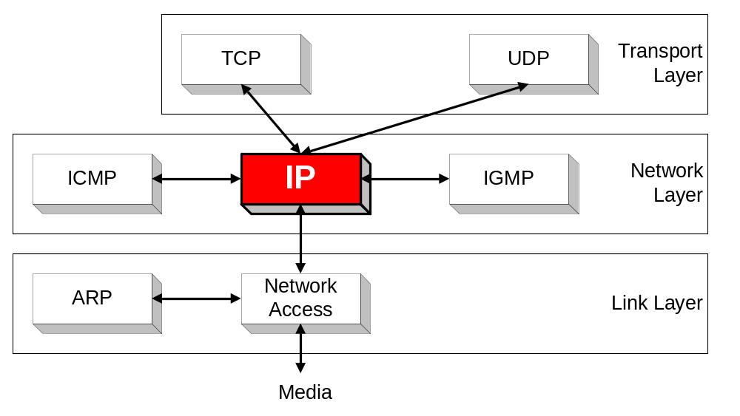
Orientation
IP (Internet Protocol) is a Network Layer Protocol.
IP’s current version is Version 4 (IPv4). It is specified in RFC 891.

Slide 3
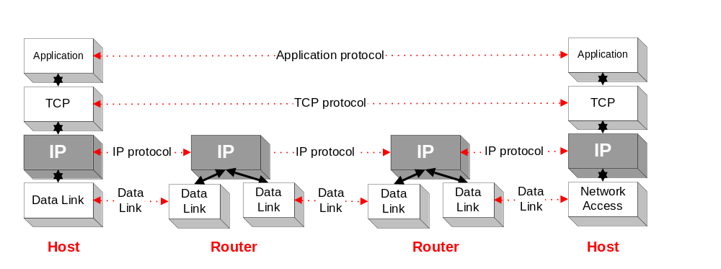
Application protocol
IP is the highest layer protocol which is implemented at both routers and hosts

Slide 4
IP Service
Delivery service of IP is minimal
IP provide provides an unreliable connectionless best effort service (also called: “datagram service”).
  Unreliable: IP does not make an attempt to recover lost packets
  Connectionless: Each packet (“datagram”) is handled independently. IP is not aware that packets between hosts may be sent in a logical sequence
  Best effort: IP does not make guarantees on the service (no throughput guarantee, no delay guarantee,…)
Consequences:
Higher layer protocols have to deal with losses or with duplicate packets
Packets may be delivered out-of-sequence

Slide 5
IP Service
IP supports the following services:
    one-to-one (unicast)
    one-to-all (broadcast)
    one-to-several (multicast)
IP multicast also supports a many-to-many service.
IP multicast requires support of other protocols (IGMP, multicast routing)
unicast
broadcast
multicast

Slide 6
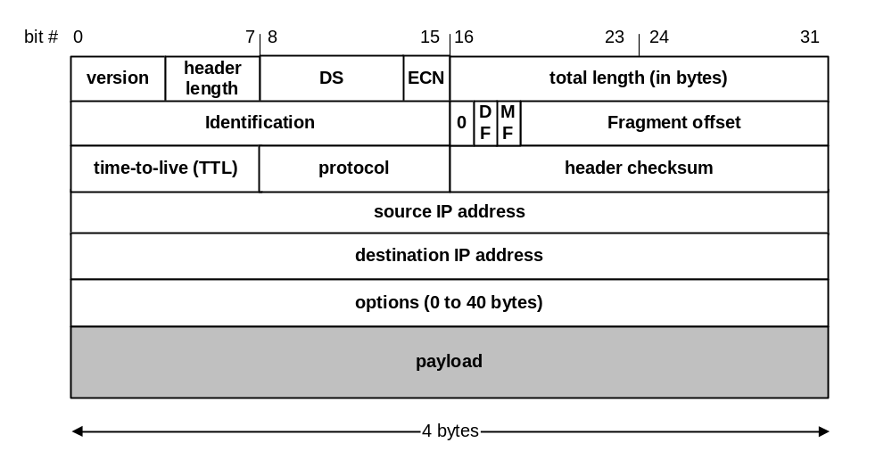
IP Datagram Format
20 bytes ≤ Header Size < 2⁴ x 4 bytes = 60 bytes
20 bytes ≤ Total Length < 2¹⁶ bytes = 65536 bytes

Slide 7
IP Datagram Format
Question: In which order are the bytes of an IP datagram transmitted?
Answer:
    Transmission is row by row
    For each row:
        1. First transmit bits 0-7
        2. Then transmit bits 8-15
        3. Then transmit bits 16-23
        4. Then transmit bits 24-31
This is called network byte order or big endian byte ordering.
Note: Many computers (incl. Intel processors) store 32-bit words in little endian format. Others (incl. Motorola processors) use big endian.

Slide 8
Big endian vs. small endian
Conventions to store a multibyte work
Example: a 4 byte Long Integer Byte3 Byte2 Byte1 Byte0
Little Endian
Stores the low-order byte at the lowest address and the highest order byte in the highest address.
Base Address+0 Byte0
Base Address+1 Byte1
Base Address+2 Byte2
Base Address+3 Byte3
Intel processors use this order
Big Endian
Stores the high-order byte at the lowest address, and the low-order byte at the highest address.
Base Address+0 Byte3
Base Address+1 Byte2
Base Address+2 Byte1
Base Address+3 Byte0
Motorola processors use big endian.

Slide 9
Fields of the IP Header
Version (4 bits): current version is 4, next version will be 6.
Header length (4 bits): length of IP header, in multiples of 4 bytes
DS/ECN field (1 byte)
  This field was previously called as Type-of-Service (TOS) field. The role of this field has been re-defined, but is “backwards compatible” to TOS interpretation
  Differentiated Service (DS) (6 bits):
    Used to specify service level (currently not supported in the Internet)
  Explicit Congestion Notification (ECN) (2 bits):
    New feedback mechanism used by TCP

Slide 10
Fields of the IP Header
Identification (16 bits): Unique identification of a datagram from a host. Incremented whenever a datagram is transmitted
Flags (3 bits):
  First bit always set to 0
  DF bit (Do not fragment)
  MF bit (More fragments)
  Will be explained later→ Fragmentation

Slide 11
Fields of the IP Header
Time To Live (TTL) (1 byte):
  Specifies longest paths before datagram is dropped
  Role of TTL field: Ensure that packet is eventually dropped when a routing loop occurs
  Used as follows:
  Sender sets the value (e.g., 64)
  Each router decrements the value by 1
  When the value reaches 0, the datagram is dropped

Slide 12
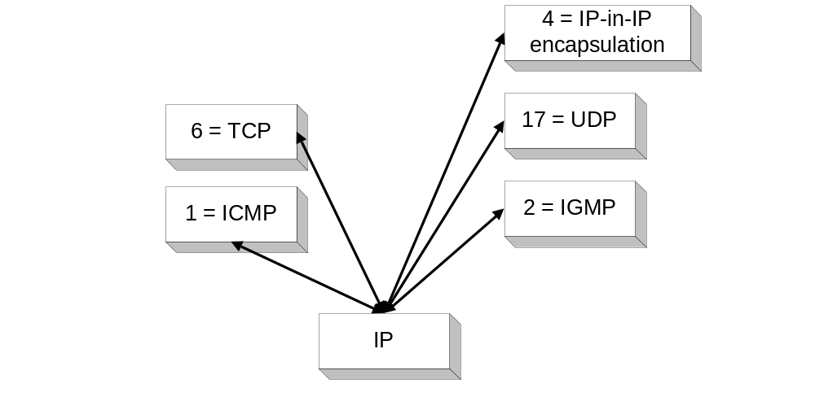
Fields of the IP Header
Protocol (1 byte):
    Specifies the higher-layer protocol.
    Used for demultiplexing to higher layers.
Header checksum (2 bytes): A simple 16-bit long checksum which is computed for the header of the datagram.

Slide 13
Fields of the IP Header
Options:
    Security restrictions
    Record Route: each router that processes the packet adds its IP address to the header.
    Timestamp: each router that processes the packet adds its IP address and time to the header.
    (loose) Source Routing: specifies a list of routers that must be traversed.
    (strict) Source Routing: specifies a list of the only routers that can be traversed.
Padding: Padding bytes are added to ensure that header ends on a 4-byte boundary

Slide 14
Maximum Transmission Unit
Maximum size of IP datagram is 65535, but the data link layer protocol generally imposes a limit that is much smaller
Example:
  Ethernet frames have a maximum payload of 1500 bytes
  → IP datagrams encapsulated in Ethernet frame cannot be longer than 1500 bytes
The limit on the maximum IP datagram size, imposed by the data link protocol is called maximum transmission unit (MTU)
MTUs for various data link protocols:
  Ethernet: 1500 FDDI: 4352
  802.3: 1492 ATM AAL5: 9180
  802.5: 4464 PPP: negotiated

Slide 15
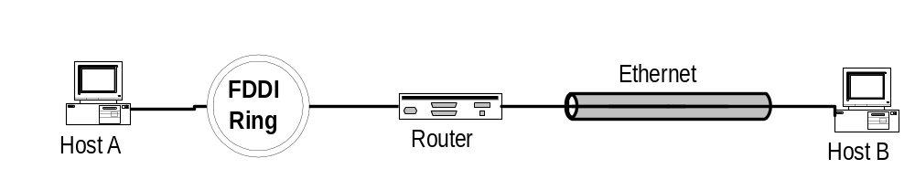
IP Fragmentation
What if the size of an IP datagram exceeds the MTU?
IP datagram is fragmented into smaller units.
What if the route contains networks with different MTUs?
MTUs: FDDI: 4352 Ethernet: 1500
Fragmentation:
  IP router splits the datagram into several datagram
  Fragments are reassembled at receiver

Slide 16
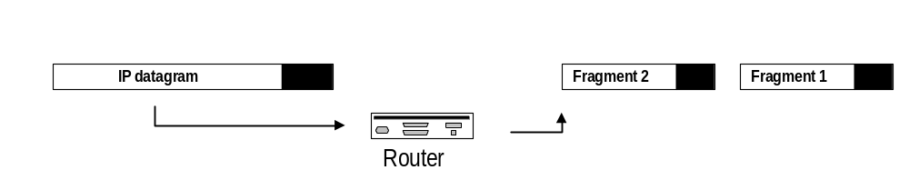
Where is Fragmentation done?
    Fragmentation can be done at the sender or at intermediate routers
    The same datagram can be fragmented several times.
    Reassembly of original datagram is only done at destination hosts !!

Slide 17
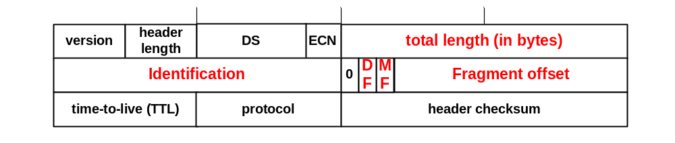
What’s involved in Fragmentation?
The following fields in the IP header are involved:
Identification When a datagram is fragmented, the identification is the same in all fragments
Flags
DF bit is set: Datagram cannot be fragmented and must be discarded if MTU is too small
MF bit set: This datagram is part of a fragment and an additional fragment follows this one

Slide 18
What’s involved in Fragmentation?
The following fields in the IP header are involved:
Fragment offset Offset of the payload of the current fragment in the original datagram
Total length Total length of the current fragment

Slide 19
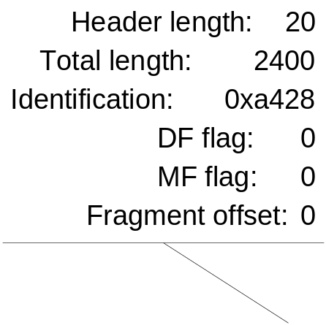
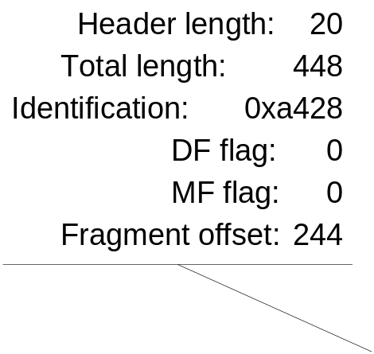
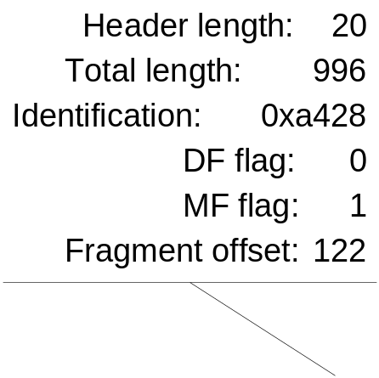
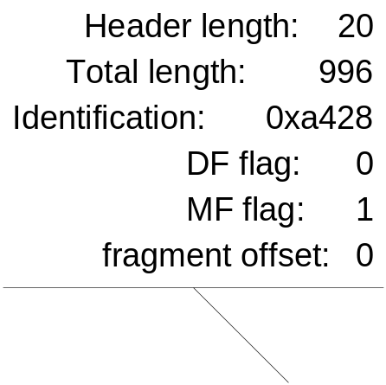
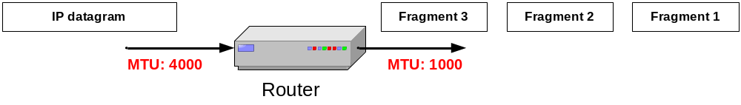
Example of Fragmentation
A datagram with size 2400 bytes must be fragmented according to an MTU limit of 1000 bytes

